Slide 1
Women4Business
rgough01:
Iamila /mran
Supplier Diversity -
How we can help you
Notes:
Jamila to kick off
“Welcome everyone to our Supplier Citizenship workshop focused on Supplier Diversity – this is the 8th workshop out of a series of 11, which we’ve been putting together to help our supply partners with some inspiration and some tips on selected Citizenship areas.
I hope you had a chance to join few of these and if not, no worry, you can access all recording on the Idloom platform till end July and then on pgsupplier.com
My name is Jamila Belabidi, I am the Purchases Director in charge of Global SD and Women Economic Empowerment at P&G, from Geneva.
I have the immense pleasure today to host this workshop focused on a SD tool, resulting from the collaboration between Kearney, Women’s Forum, WEConnect, P&G and others. The objective is to help you start, build and grow Supplier Diversity program globally.
The thought leaders and architects behind this effort are with us today – and I am handing over to Imran Dassu, a partner of P&G and a partner at Kearney, who will take us thru this journey.

Slide 2
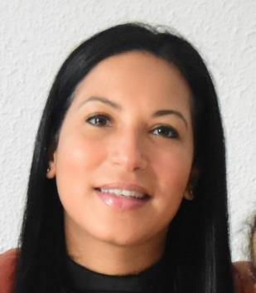
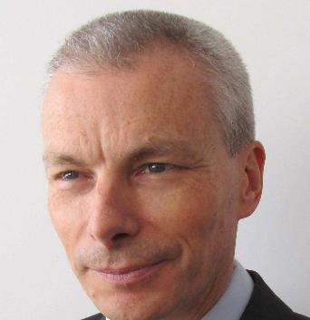
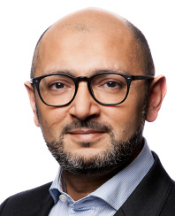
We’re here to help with your supplier diversity programs
rgough01:
Imran
Jamila Belabidi
P&G Purchases Director
Global Supplier Diversity & Women Economic Empowerment
Herve Menassol
P&G Global Capital Purchases Senior Director
jburto02:
Awaiting input from Herve
Imran Dassu
Kearney
Partner, Procurement
Becky Roberts
Kearney
Senior Consultant
Kearney are the #1 leader in the Procurement space, having led most of the procurement breakthroughs in the past 35 years
Kearney is a recognized Supplier Diversity thought leader among industry peers and organizations
Notes:
Imran to take over – share more topic intro words?? And then introduce the rest of the team (no need for Jamila)
With us as well is Herve Menassol, our Global Capital Senior Purchases Director from Brussels. Herve had played a significant role in helping our P&G Capital Suppliers access the survey and helping us shape the work to set up this tool. You will hear his testimony as to how this is an interesting approach to help advance this effort in an efficient and structured way.

Slide 3
We’ll spend about an hour on the following topics
rgough01:
Imran
Agenda
Why is supplier diversity important?
P&G and Supplier Diversity
Supplier Diversity Programs: the landscape
Defining your roadmap: Inclusive Sourcing Journey
Q&A and discussion
Notes:
30 mins/ 30 mins split

Slide 4
rgough01:
Imran
224 million women entrepreneurs^{1….}
…participating in the ownership ~35% of firms globally.²
But…<1% of global corporate or government spend is on women-owned business³
4
1. Kelly, D. et al, (2014). ‘Gem Special Report: Women’s Entrepreneurship’. Global Entrepreneurship Research Association. 2014.
2. World Bank. (2018). World Development Indicators: Women and Development. World Bank World View.
3. Vasquez, E.A. & Frankel, B. (2017). ‘The business case for global supplier diversity and inclusion: the critical contributions of women and other underutilized suppliers to corporate value chains’. WEConnect International. Washington.
Source: Women’s Forum - Unmasking the value of women’s economic empowerment in supply chains
Notes:
There are approximately 224 million women entrepreneurs worldwide¹ who participate in the ownership of around 35% of firms in the formal economy.
However, on average, less than 1% of global corporate or government spend is on women-owned business in any country.³

Slide 5
Kearney and P&G are working with leading organisations across industries to accelerate economic empowerment and inclusion for women
rgough01:
Imran
The Women4Business Daring Circle is a network of corporate partners committed to improving opportunities for Women in Business
Insight partner
Knowledge partner
Editorial partner
Strategic members & partners
Notes:
Jamila to send in chat – link to the WF daring circle page; https://www.womens-forum.com/daring-circles/women-for-business/

Slide 6
rgough01:
Imran
Diversity in Supply Chains is becoming an increasingly important issue in the global business community
Responses to ‘Do you have a supplier diversity program operating in Europe⁽¹⁾?
Commitments from P&G
Currently spend more than $1.1Bn with female owned businesses
Committed to achieving 50/50 male/female representation in & outside of P&G
Don’t know
61% of companies have, or intend to develop a program, compared with 54% in 2019 – a 7% pt leap
Intend to
Yes
2019
2020
Other organisations with public commitments to supply chain diversity….
A diverse supplier is a business owned (51%+) by an individual or group that is part of a traditionally underrepresented or underserved group. (Most commonly ethnic and gender groups)
Inclusive procurement promotes competition in the supply base
Supplier Diversity programs help:
Promote innovation
Drive competition
Address the emergence of new consumer expectation and needs
(1) Based on 145 respondents to 2020 survey
Source: Kearney and Women4Business Daring Circle
...and many, many more
Notes:
Voiceover:
- # of conversations we’ve had in this space has multiplied (Kearney experience with own customers)
P&G is constantly challenging itself. today we spend 1.1Bn$ and working on a bold commitment to be announced soon.
P&G and Kearney want to be role models but also want to be thought leaders, and help the industry to come along with these type of interventions such as the tool. We want to be a force for good for the industry

Slide 7
rgough01:
Imran
Women4Business Daring Circle
Survey Response Document
P&G Supplier Responses
Notes:
We’re now going to take you through some of the key findings from the annual supplier diversity survey

Slide 8
We run an annual survey to understand and track progress of supplier diversity programs…
rgough01:
Herve
P&G suppliers are very well represented in this survey
Thank You!
Notes:
Herve to:
thank P&G suppliers for their participation – 76 of our suppliers completed the survey. Over 52% of the total survey responses. Very proud of P&G suppliers engagement in such critical topic (I assume that we will all agree that data shared earlier re-enforce that we need to accelerate )
for helping us invest in building infrastructure (which ultimately help suppliers... and help us identify where to support more)
as the Kearney team take you through the survey results for P&G suppliers, bear in mind that it tells us what is happening but now how it is happening... (we do not always know why.. we have the what..)
@Herve – do not hesitate to share your testimonial here.. How this felt? The process to call your suppliers and how most of them if not all reacted positively…
Calling to get at least 30 replies in Capital
Talking to the right level: Sales VP, Board member, CEO
We will do a thinner analysis on Capital, still on anonymous data to engage in more specific actions.
This is important to me as you will see that Europe is behind the rest of the world (of build on slide 10)
I’m now going to hand over to the Kearney team again to take you through some more detail of the results

Slide 9
rgough01:
Becky
The proportion of P&G suppliers that have diversity programs has increased by 9% pts from 2019, however, 38% of you are yet to initiate a program
% of respondents that have a supplier diversity and/or gender-responsive procurement program operating in Europe
Gender-responsive
Suppliers
All Respondents
Gender-responsive
Supplier diversity
Supplier diversity
No/ Don’t
know
24%
Yes
No/ Don’t
know
23%
Yes
16%
Increase of 9% pts since 2019, but program implementation is still lagging behind the broader population by 5%
Both
21%
Intend to¹
Both
Compared with 33 % in 2019
Intend to¹
Respondents intend to develop a program within 3 years
Other primarily includes packaging, health and miscellaneous other businesses
Source: Women’s Forum Survey; Kearney Analysis
Notes:
All of these slides will be available after the event, so you will be welcome to deep dive into any of these graphs in more detail. I will just give you a very high level overview.
This shows a really positive trend, but of course there is always more than can be done and compared to the broader population, P&G suppliers are trailing behind

Slide 10
rgough01:
Becky
P&G suppliers are ahead of the game except in industrial sectors,
and in Europe vs their counterparts (consistent pattern overall)
Yes-has programme(s)
Intends to
No/Don’t know
% with program by industry
Suppliers
All Respondents
Financial and Professional Services
0%
5
18
Transport, Travel and Infrastructure
1
12
Consumer Goods
12
19
Communications, Media and Technology
5
16
Energy and Process Industries
14
4%
28
Automotive, Aerospace and Industrial Products
24
28
Other²
15
²
24
% with program by location of headquarters
Europe
52
95
North America
14
37
Rest of World
10
13
Declining total reflects survey participant drop-outs
Other primarily includes packaging, health and miscellaneous other businesses
Source: Women’s Forum Survey; Kearney Analysis
Notes:
I changed the title…. To make it more positive while highlighting opportunity areas.
If we then deep dive into the split across industry and location, we can see that at first glance, there is a general trend across industry where P&G suppliers broadly match the total population. As expected, transport, travel and infrastructure has very low representation, whereas AA, particularly inustrail processes has the highest representation and a strong % of suppliers with a program.
If we look at the location distributions, again as expected there is a focus around Europe. This also broadly matches with the general population of respondents. However one key data point to pull out here is the comparatively low number of P&G’s European suppliers with a program - Europe 33% vs. 39% is a marked difference in Europe suppliers that have a diversity program when we look at the total numbers this represents. 17 vs. 37. Clearly much room for growth here.

Slide 11
rgough01:
Becky
Meeting CSR targets and ‘doing the right thing’ are the primary drivers for your programs, but there has been a huge jump in those of you who need to deliver on CEO commitments
Primary drivers of a supplier diversity and/or gender-responsive procurement program at respondents’ firms¹ (multiple answers possible)
Overall Result⁽²⁾
Diversity and Inclusion or CSR commitments / Right thing to do
85%
83% (1)
Up to #2 from #9 in 2019 for P&G suppliers
Delivering on CEO / executive committee commitments
33%
31% (3)
Lower than the general trend at 33%
Access to innovative goods or services
26%
33% (2)
Cost-effectiveness
22%
22% (4)
21% (5)
Risk diversification in supply chains
17%
Regulatory guidance/ requirement – existing or anticipated
18% (6)
17%
# = unique respondents % = % of all firms
8% (7)
Other / I don’t know
7%
…But, there is a striking increase in the number of firms reporting ‘delivering on executive commitments’, and ‘responding to regulatory pressures’ as primary drivers. This suggests a rapid shift of focus towards this issue by both corporates and governments
1. Question was completed by 46 firms; 2. Compared against all respondents of the 2020 survey
Source: Women’s Forum Survey; Kearney Analysis
Notes:
If we then deep dive into the primary drivers and motivations for P&G’s suppliers, we can see that meeting corporate social responsibility and doing the right thing are the primary drivers. This again maps across the population of all respondents to the survey, not just P&G.
Of particular significance here is finding #2. P&G have stated that having a diversity program is now an integral part of their business strategies.. Its no longer just a nice to have anymore. And this extends of course across the P&G suppliers.
“read through slides!

Slide 12
Discussion: Please use the comments box
rgough01:
Becky
What are your barriers to implementing a supplier diversity program?
Notes:
So I just want to pause here for you to reflect on this a little, as I take you through the results from the survey regarding the P&G respondents primary barriers to effective implementation of a supplier diversity programme
We’d really love to hear more from you as attendees of today’s talk to understand your barriers to implementing a diversity program with your suppliers. Please feel free to add your thoughts in the comment box throughout the rest of this presentation
PAUSE

Slide 13
rgough01:
Becky
P&G Suppliers report challenges meeting their objectives and delivering value, most notably difficulties in finding suitable suppliers
Key challenges for effective implementation of supplier diversity and/or gender-responsive procurement program (multiple answers possible)
# of respondents with a program saying attribute is ‘very important’ and % saying the driver is ‘very present’
Difficulty in finding suppliers that meet the requirements of the programme
55%
Clear alignment with corporate objectives and goals
78%
54%
Many suppliers unable to compete as under-resourced or lacking visibility
36%
Access to suppliers is the #1 challenge by a long way
Leadership commitment and active promotion
65%
38%
Insufficient access to relevant data
34%
Setting and measuring progress against targets
54%
Consistently ranked as the top two most important drivers
These are the 3 top challenges in the aggregated report; however suppliers lacking visibility was ranked #3 at 32%
Lack of infrastructure
23%
34%
Understanding where to start
20%
Ability to integrate programme into procurement processes
41%
27%
Measuring and demonstrating the business case / value
14%
30%
Dedicated resourcing for programme
18%
Regulatory challenges (e.g. concerns/lack of clarity around positive discrimination)
14%
Actively supporting suppliers e.g. with finance, training, sharing best practices
30%
Other
13%
Yet only a small proportion of firms consider membership to external bodies (who could provide support) as an important
16%
Membership of / signatory to external bodies e.g. UN, WEP, WEConnect
24%
Attibute is "Very Important"
Lack of senior-level buy-in
7%
16%
Attibute is "Very Present"
Source: Women & Business Daring Circle Survey; Kearney Analysis
Notes:
Whilst you’re thinking about that, I just wanted to take you through the findings on this from the survey at a high level. As I mentioned, all of these slides will be available to you: this will be on both the idloom platform and on pgsupplier.com.
From the survey, it was clear that access to diverse suppliers was the number 1 challenge. Etc. talk through

Slide 14
rgough01:
Becky
More than half of you are looking for guidance on best practices in implementing your program
% of respondents that are ‘very interested’ in components to develop and strengthen a supplier diversity and/or gender-responsive procurement program
Overall Result²
Best-practices in implementation
51%
50% (1)
Relevant policies and standards
41%
31% (4)
Existing initiatives and organisations that provide support
40% (2)
33%
34% (3)
Key stages of implementation
33%
28% (5)
The business case for action
21%
Source: Women’s Forum Survey; Kearney Analysis
Notes:
If we deep dive into this a bit further, feedback was that more than ½ of the P&G suppliers that responded would like more guidance on best practices. So this is clear and actionable change that I know P&G are working through.

Slide 15
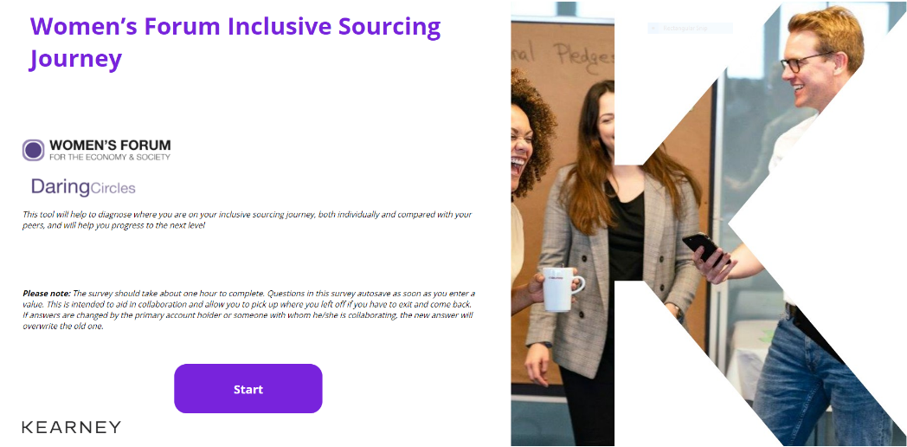
You want to understand more about implementation
rgough01:
Becky
So we have developed a self-service tool to help with this
Notes:
Tool is a way for you as an organisation to assess your supplier diversity. Your organisation will then be benchmarked against your peers in terms of your supplier diversity maturity and given recommendations for how to progress to the next level

Slide 16
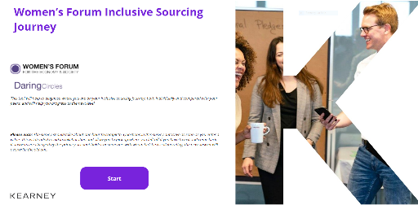
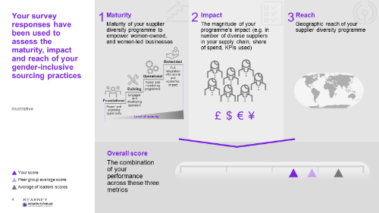
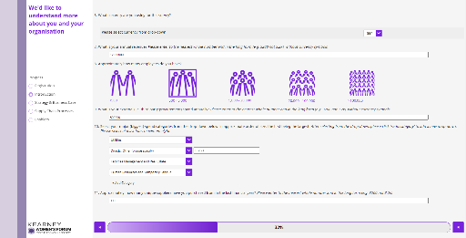
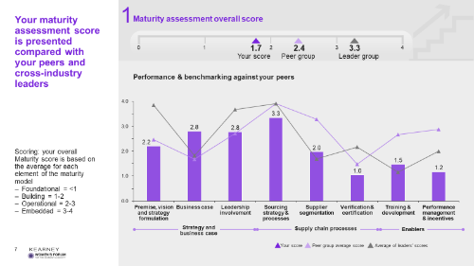
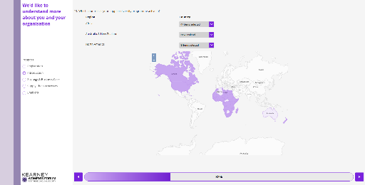
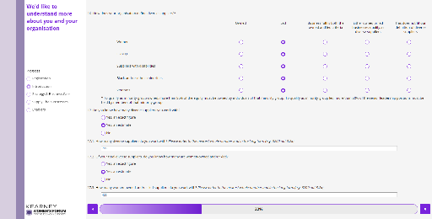
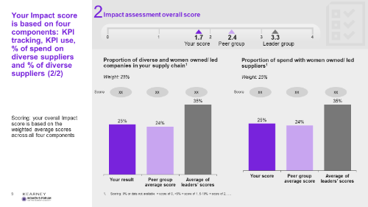
The new Kearney Inclusive Sourcing Journey Tool helps businesses develop a roadmap to improving diversity in their supply chain
rgough01:
Becky
Herve to re-enforce
Inclusive Sourcing Journey Questionnaire
Online self-assessment tool
Available via the Kearney website
Benchmarking and Roadmap Report
Individualized output report
The output will help participants build a successful supplier diversity program
The objective is to assess and benchmark the current procurement practices of organisations, and to generate a customized roadmap of the actions and key steps they should take to enable diversity and women’s empowerment in their supply chains
Notes:
Talk through process
So this is your call to action. If you want to know where you stand against your peers and how to improve and develop your supplier diversity, complete the survey. Once we reach roughly 200 responses, we will be able to share your complete benchmark report and next steps for action
ask suppliers in the call to fill it themselves and if they can also push out this to their suppliers too (40 mn investment)
Herve to re-enforce using the tool

Slide 17
The ISJ benchmarks your practices against peers in 3 key areas….
rgough01:
Becky
ISJ Maturity Model Outline
The maturity model considers 3 key areas related to how a Procurement Function is set up, and how these areas can support gender-inclusive purchasing
Clear strategy & Business Case
1
Premise, vision and strategy formulation
Business case
Leadership involvement
Supply Chain Processes
2
Sourcing strategy & processes
Supplier segmentation
Enablers
Verification & certification
3
Training & Development
Performance Mgmt. & Incentives
Notes:
To expand on what you will receive, etc.
1. Plotted against three key areas:

Slide 18
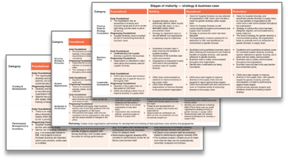
…to diagnose your current level of maturity for inclusive sourcing…
rgough01:
Becky
ISJ Maturity Model Summary
Foundational
Overall, you are here!
Building
Operational
Embedded
Strategy & business
case
CXOs support Diversity & Inclusion (D&I), but the supplier diversity vision is not set-out yet and there is no business case
No formal requirements for increasing diversity in supply chains, and no data collection on diverse suppliers
General D&I training available – focus on supply chains not included yet
Supplier diversity vision and qualitative business case are in place
Requirements for increasing diversity in supply chains not fully embedded;
Limited data collection on diverse suppliers
Diversity in supply chains included in general D&I training;
Modest ad-hoc bonus linked to performance on diversity
Well-communicated vision for supplier diversity (incl. gender diversity), and strategy to achieve vision; qualitative and quantitative business case in place
Formal requirements for diversity in supply chains
Data on supplier diversity available
Ad-hoc external certification for diversity in supply chains
Supplier diversity training required for procurement staff; senior staff performance review includes diversity KPIs
Well-communicated vision for supplier diversity (incl. gender diversity), and strategy to achieve vision being rolled out; qualitative and quantitative business case in place
Formal requirements for diversity in supply chains
Data on supplier diversity available
Systematic external certification for diversity in supply chains
Supplier diversity training required for procurement staff and is offered to suppliers; senior staff renumeration linked to diversity KPIs
You are here!
Supply chain processes
You are here!
Enablers
You are here!
Notes:
2. Current maturity diagnosed
Provide a perspective on each of the 4 areas are – what each of them are at a high level
Foundational – getting started, thinking about doing something etc. No business case, metrics etc.
Building – just getting into it more, business case, might not have numbers etc.
Operational – starting to get wiring in place, connect across the organisation etc. connecting different unctionsl
Embedded – it is across the entire organisation.
Al ot of detail behind it, will give you more granular feedback etc.

Slide 19
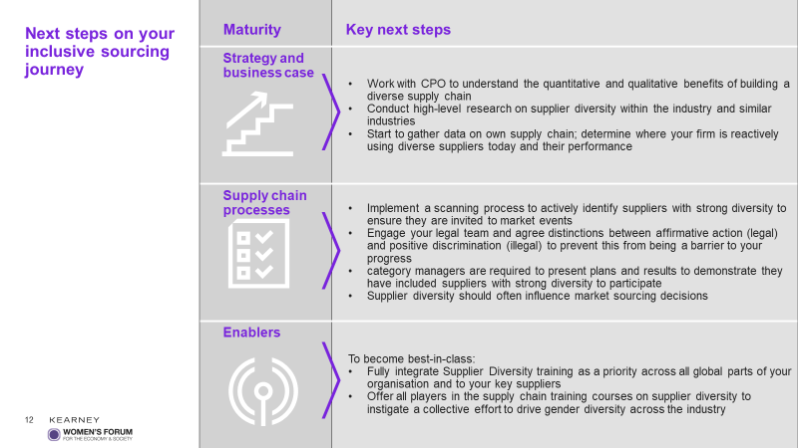
…and makes recommendations on how you can take steps to improve your inclusive sourcing practices
rgough01:
Becky
Notes:
3.Given bespoke recommendations for next steps based on your level of maturity

Slide 20
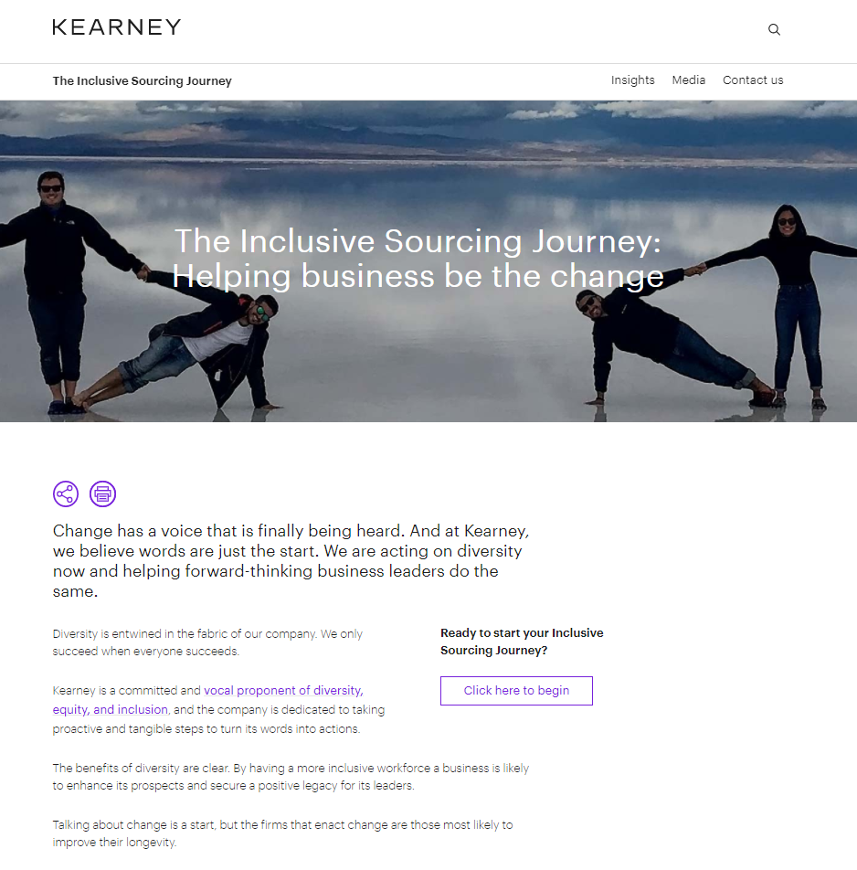
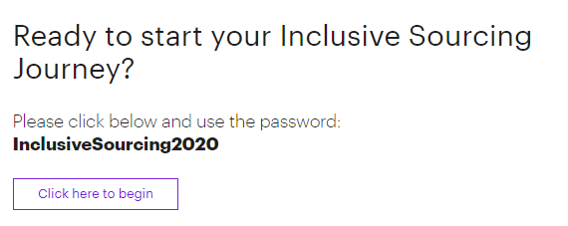
The ISJ is accessible via the Kearney website, and participation is free
rgough01:
Becky
https://www.kearney.com/web/the-inclusive-sourcing-journey
Notes:
How to access
If need any help or continue the conversation, issues, suggestions etc. we’d love to hear from you. Jamila will now talk you through how to get in touch at the end of the session
Jamila to send in the chat the link to the tool : https://www.kearney.com/web/the-inclusive-sourcing-journey

Slide 21
Engage with us ..
rgough01:
Jamila
Through your SRO
Directly to the Kearney team
(contacts details on last slide)
Supplier Diversity tool workshop: belabidi.j@pg.com
Recording will be made available on pgsupplier.com
Notes:
Closing remarks from P&G:
I hope you have learn a bit more about what is the situation for SD in Europe, and that this will translate into continued discussions and actions on your end. In particular we hope you continue or start participate in building the infrastructure we all need to settle SD in Europe and beyond.
One way is tomake your self-assessment and look for ways to evolve your SD program.
As you may have noticed, driving supplier Diversity for P&G and its supply partners but also for the industry in general is high on P&G’s agenda. We are committed to be a force for good for the industry and a force for growth for all of us.. As SD is synonym of growth for you, for us, and for diverse companies.
Now – 3 ways to engage with the team if you decide to act on this!
Through your SRO – At P&G we established SD champions in every part of the world and in every OU you interact with. If you plan to proactively bring this to your business discussion (unless already done), Your SRO will know who to connect you with the right champions.
Directly to Kearney’s team – if you want to know more about the tool itself beyond just a P&G business discussion.
Workshop – limited numbers. Get in quickly. Contact Jamila

Slide 22
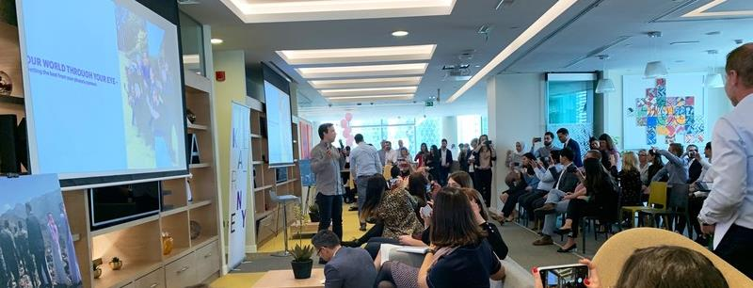
Q & A session
Please add any questions into the chat box
Notes:
We will now open the floor to any questions

Slide 23
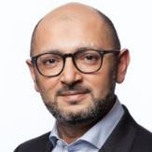
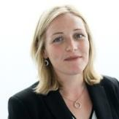
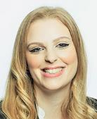
Thank You If you’d like to learn more, get in touch…
rgough01:
Imran
Imran Dassu
Partner, London
Imran.Dasu@Kearney.com
Julie Burton
Manager, London
Julie.Burton@Kearney.com
Becky Roberts
Associate, London
Rebecca.Roberts@Kearney.com
Recording will be made available on Idloom and then on pgsupplier.com
Notes:
We will now open the floor to any questions

