Slide 1


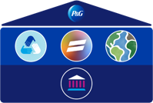
P&G RESPONSIBLE
SOURCING PROGRAM –
SOCIAL AUDITS
May 11, 2021

Slide 2

Welcome/Opening Remarks Sunita Roy Dias
Sedex Methodology & Niall Watson &
Responsible Sourcing Program Sonia Mangat
SGS – P&G Global Audit Partner Denise Dawsey
Q&A All
Closing Remarks Nalini Bates
WORKSHOP
OVERVIEW
Notes:
I like to extend warm welcome on behalf of the Global Supplier Citizen Team, Sedex, SGS, All P&G Buyers and P&G Spocs to all our supplier participants joined so far and still joining. A very good day to all of you, Hope you and your families are doing well and safe.
As we start with Introductions. Let me introduce myself first. My name is Sunita Roy Dias and am based in India-Mumbai. Am accountable for the responsible sourcing – Social Audit space across the globe along with my team Nalini Bates, Alicia Carlisle and Saurav Kumar.
It gives me great pleasure to introduce Nalini Bates Our Senior Director Leader Global Supplier Citizenship. Nalini has provided us with Guided Steps on how to approach Social Audits Globally and would support us today in answering some of your most important questions with her valuable experience in this space along with the team and global partners in this session. 😊
We also have our Global representative from Sedex - Niall Watson & Sonia who partners us in Social Audit Compliances. Sedex provide us with an extraordinary repository tool to keep us always up to date in context with Social Audits as well as in providing us with experts solutions on SMETA needs to help P&G and our Suppliers have a smooth journey.
I am also glad to introduce Denise Dawson our SGS Global Representative. SGS has partnered with P&G in providing us Standard solution as per the need of the law in the country for getting our supplier sites audited.
Along with Nalini, Niall, Sonia & Denise our entire Global Supplier Citizenship team is here with us. We are happy you could join us.

Slide 3

INTRODUCTION
P&G RESPONSIBLE
SOURCING PROGRAM –
SOCIAL AUDITS
HOW TO LEVERAGE SOCIAL AUDITS AS A TOOL TO MONITOR
SUPPLY CHAIN RISK
Notes:
As the workshop title suggest We come to you on How to Leverage Social Audits as a tool to monitor supply chain risk. Which enables businesses to assess their sites and suppliers to understand working conditions in their supply chain. It has been already a proven fact that A social audit is one of the best ways to understand the working conditions at a supplier site. An auditor physically attends the site – or workplace – of a business, enabling the auditor to assess the conditions on the ground. Here you can in this workshop learn more about, SMETA (SEDEX Members Ethical Trade Audit) 2 Pillar Audit which looks at Health and Safety and Labor Standards & 4 Pillar Audit which Looks at Health and Safety, Labor Standards, Environment and Business Ethics which is a preferred Audit requirement of P&G from their suppliers, We shall also understand Sedex’s Responsible Sourcing Program and SMETA Methodology While SGS will be covering practicality of the Audit Process.

Slide 4

Why Social Compliance is Important to P&G
Sunita

Slide 5
Introduction to Sedex
Niall Watson
Relationship Manager
(Supporting P&G)
Sedex

Slide 6


One of the world’s leading ethical trade service providers, working to improve working conditions in global supply chains. We provide practical tools, services and a community network to help companies improve their responsible and sustainable business practices and source responsibly.

Slide 7

About Sedex
SUPPLIER ETHICAL DATA EXCHANGE
Sedex aims to provide positive solutions to our members, enabling them to address negative impacts affecting workers within their supply chains.
Our tools and services supports members to identify, prevent, and account for human rights and environment impacts caused by or linked to their business operations.
We have 16 years’ expertise | 62,000+ member companies
World’s largest ethical data exchange platform
Tools to assess business practices and risk in supply chains
We reach 33 million people globally in 180 countries.
Sedex owns the SMETA Social Audit Methodology

Slide 8

































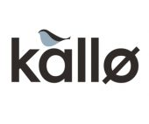














Our members

Slide 9
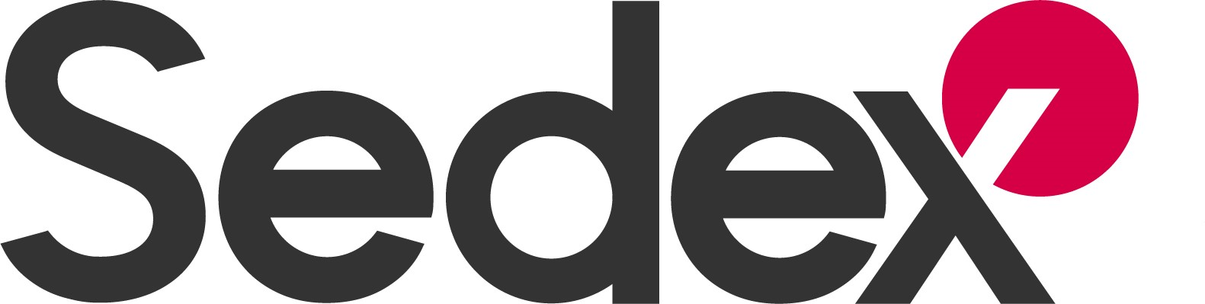
Social Audit Value Chain
Supplier

Slide 10
Social Audit Value Chain
Supplier
Customers
(i.e. P&G)

Slide 11
Social Audit Value Chain
Supplier
Customers
(i.e. P&G)
Audit Firm

Slide 12
Social Audit Value Chain
Manages own data
Views supplier data and risk analysis
Supplier
Customers
(i.e. P&G)
Sedex
Audit Firm
Uploads Social Audit Reports to Sedex

Slide 13
Affiliate Audit Companies
An Affiliate Audit Company (AAC) is an audit company that can conduct SMETA and other social audits for Sedex members. Audit companies must meet a set of criteria to be a Sedex AAC and have a Sedex Affiliate Auditor account to conduct SMETA audits.
ABS Quality Evaluations Inc.
Accordia Global Compliance Group
BSI Group
Bureau Veritas
Control Union Certifications
DNV
International Compliance Group
INTERTEK
Lloyd’s Register
LSQA
NSF Certification UK Ltd
Partner Africa
SGS
TUV Rheinland
Verisio Ltd
Verner Wheelock (incorporating KSSA)

Slide 14
What is Responsible Sourcing and why it matters to businesses?
Sonia Mangat
Responsible Sourcing Manager
Sedex

Slide 15
What is Responsible Sourcing?
Responsible sourcing is an approach to sourcing – it covers social and environmental responsibility within value chains, across everything a company buys.
The aim of responsible sourcing is to ensure business activities do not have a negative impact (and even have a positive impact) on people and the environment.
To do this businesses actively source products and services for their operations in an ethical, sustainable and socially and environmentally responsible way

Slide 16


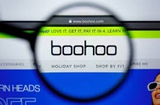
What is the issue?
Poor working conditions, human rights abuses and modern slavery are still prevalent
In 2013, the Rana Plaza garment factory collapse in Bangladesh killed 1,134 people due to lack of fire safety standards. This caused reputational damage for hundreds of international retailers sourcing here.
In 2013, the horse meat scandal was a food industry scandal in parts of Europe in which foods advertised as containing beef were found to contain undeclared horse meat. This erupted in huge reputational damage for many supermarkets.
In 2020, it was reported Boohoo sourced from a factory paying workers half the minimum wage, leading to a 30% drop in share prices within one month.
Notes:
What happens when businesses don’t respect human rights and source responsibly.
KEY TAKE AWAY HERE:
Impacts can be very serious
Impacted companies are often the brands at the top of the supply chain…this exploitation or poor food safety is not happening in their own businesses, it is in their suppliers. But it is the trusted brand who’s reputation suffers too.
They don’t just relate to the issue at hand, potentially reflect a much greater risk of poor governance and oversite within a business in general.

Slide 17
Isolated Cases or a Global Issue?
Globally 21% of workers in 2018 live in extreme or moderate poverty – i.e. their job does not lift them out of impoverished living conditions.
20,995 instances of social security and employment benefits unpaid across Sedex audits in 2019; 11,260 cases of excessive working hours.
In the UK estimated 420,000 workers receive less than the minimum wage, & approx. 1/5th workers entitled to the National Living Wage did not receive it.

Slide 18
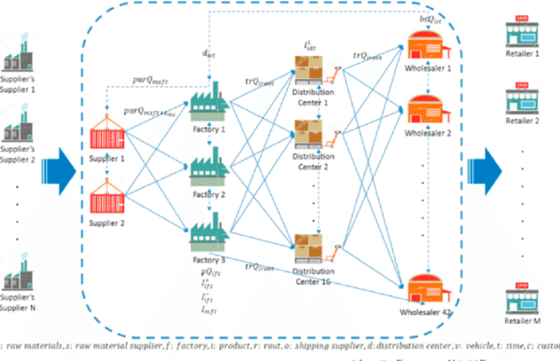
Complex supply chains
Supply chains are the companies and people involved in making the products or services sold.
Multinational companies often have global and very complex supply chains.
Therefore, companies like P&G therefore rely on their EBP’s to support them in trying to identify and eradicate some of these issues
`

Slide 19
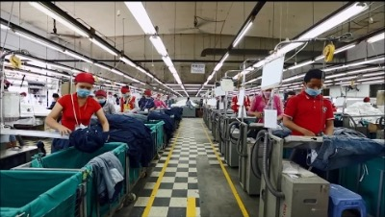
Benefits of sourcing responsibly?
It’s good business sense
Did you know?
In 2018, a global FMCG Co. found that their more responsible brands– grew 69% faster than the rest of its business
Research from McKinsey finds that 70% of a company’s earnings could be negatively impacted by publicised sustainability issues
Research across 60 countries shows 66% of global consumers are willing to pay more for sustainable goods. Millennials are even more willing at 73%.
Consumer demand and expectations
Improve staff loyalty and become more attractive to prospective employees
Compliance with national and international laws and legislation
Pro-actively manage risks, make informed business decisions and build a resilient supply chain
Protects business and brand reputation
More attractive investment prospect
Profitability and return on investment - better business performance

Slide 20

What is a Social Audit?
Why are the crucial to sourcing responsibly?
A formal examination of a workplace, site or company’s operations. The audit aims to check practices against a defined standard, such as a code of practice or technical specification and uses corroborated evidence to do this.

Slide 21
Introduction to SMETA
SEDEX MEMBERS ETHICAL TRADE AUDIT
One of the most widely used social / ethical audit formats in the world.
It uses a four pillar approach:
Health & safety
Labour standards
Practices at a site are assessed against the SMETA clauses, which are based on the ETI Basecode (for labour and H&S pillars).
3. Environment
4. Business ethics

Slide 22
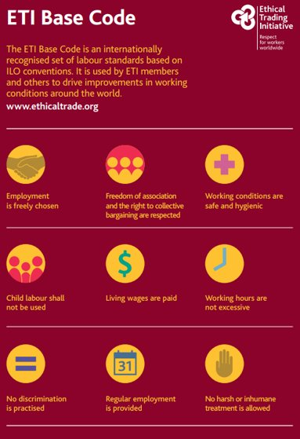
SMETA APPROACH
UNDERSTANDING THE SMETA METHODOLOGY
CLAUSES: (Areas against which the site is assessed)
  ETI Base code
  Additional areas
`
LEGAL/ CODE REQUIREMENTS: (What standard is the site required to meet?)
  ETI Basecode
  Local Law
  Customer code (if requested)
FINDINGS: (Does the site meet the standard?)
YES → Description no finding
YES → exceeds them: Good Example
YES, but…In danger of not meeting them → Observation
NO → Non-compliance

Slide 23
AUDIT EXECUTION
WHAT are the key STAGES OF a Social Audit?
OM
Opening Meeting
ST
Site tour
WI
Worker Interviews
DR
Document review
CM
Closing meeting

Slide 24
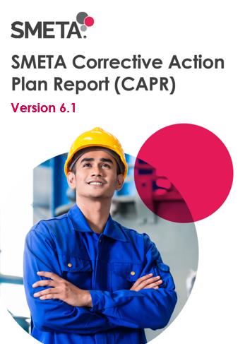
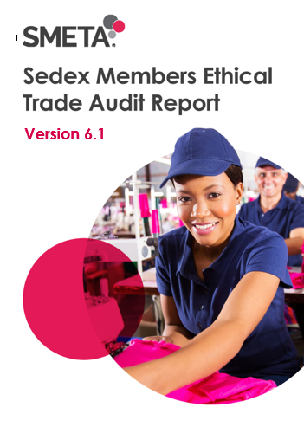
POST AUDIT
One signed original copy of the Corrective Action Plan Report provided to site.
A second copy of the Corrective Action Plan Report signed and retained by auditor long with other audit documentation.
An electronic version or the SMETA Audit Report and Corrective Action Plan Report sent to report reviewer and finally uploaded to Sedex.

Slide 25
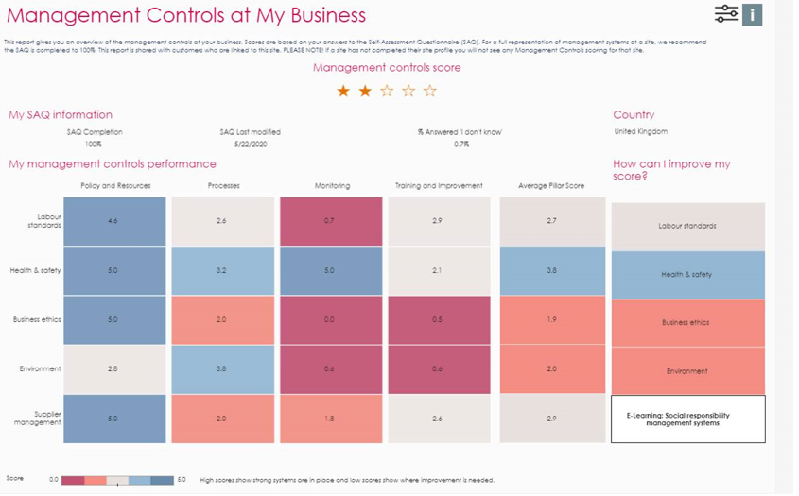
How Sedex and SMETA can help you to be a more responsible business
We offer:
Management Controls report
Guidance
Audit non-compliance resolution (for preventative actions)
Audit prep and training for suppliers (e.g. in China)
E-learning
Notes:
Rosie
Sedex has a few areas where we can support companies in preventing and mitigating human rights risks.
If we start with the SAQ and MC Report. The SAQ is set up to ask questions about what systems sites have in place to manage their risks, and its sections correspond with different Management Systems such as policies and processes.
Radar takes the answers given by sites and gives them a score. These scores are then shown in the Management Controls Report. This report shows sites where their management systems are strong and where more work is needed.
To accompany this, we have the management controls guidance, the fours chapters on LS, H&S, Environment and Business ethics. These chapters describe what a management system is and how to set them up.
Then we have guidance around how to resolve audit non-compliances. Audits can highlight where there are gaps in sites' management systems and raise when a system fails to meet the legal standard or ETI base code. As part of the corrective action plan, suppliers are told what they need to do to correct this system, and therefore prevent a harm from happening. For example, if an auditor finds that working hours at a site are not well documented and there are inconsistencies in the records. They can raise this as an NC and recommend how to keep more accurate records. This can help to ensure that working hours are properly monitored and reduce the risk that they become excessive.
In China, the team works to help prepare suppliers for audit. As with an actual audit, this can help suppliers see where there are gaps in their management systems.
We also have E-Learning, with resources on key topics labour standards topics, such as fire safety and chemical management, which can act as a guide to suppliers.
sie

Slide 26

Denise Dawsey
International Sales Manager
SGS

Slide 27
Who is SGS?
SGS is an inspection, testing & AUDITING company
In business over 140 years with 90,000+ employees, 2600 offices & laboratories globally
SGS was the first “A Member” to obtain full APSCA Membership (200+ Registered Auditors)
Over 800 APSCA registered social auditors in 80+ countries
Highly experienced & certified Auditors, with specialization in human rights, working conditions, health & safety & collective bargaining
SGS Auditors are required to speak English, as well as the local language with Awareness of the local context & relevant laws/regulations
SGS has been working with P&G since 2011, performing social & environmental responsibility audits of their valued supplier partners

Slide 28
SGS is ready to help you
What to expect:
  Contact with SGS (in preferred language)
  Fill out a simple questionnaire
  Receive a quotation, review, & sign
  Work with your local SGS office to agree on audit dates, start and finish times, receive audit agenda
  Your SGS auditor performs the on-site audit
  If Non-Conformances are found during your audit (very common!), these will be reviewed with your team & timelines agreed for remediation
  Report & CAPR uploaded by SGS to the Sedex portal
  Remediate your Non-Conformances, Notify SGS when complete & your Auditor will verify closure via desktop or on-site
  Celebrate your Success!

Slide 29
    How are audit fees calculated?
    Each country has a special P&G “Day Rate”
    The number of employees at your workplace determines the number of days the auditor spends on site per Sedex guidelines
    Reporting time (0.5 day)
    Sedex Audit Upload Fee
      Members 50 GBP
      Non-Members 150 GBP
    May be applicable:
      Auditor travel costs, if applicable (i.e. train ticket, meal, hotel)
      Local taxes, if applicable in your country
Investing in your commitment to being a responsible business
Notes:
As the workshop title suggest We come to you on How to Leverage Social Audits as a tool to monitor supply chain risk. Which enables businesses to assess their sites and suppliers to understand working conditions in their supply chain. It has been already a proven fact that A social audit is one of the best ways to understand the working conditions at a supplier site. An auditor physically attends the site – or workplace – of a business, enabling the auditor to assess the conditions on the ground. Here you can in this workshop learn more about, SMETA (SEDEX Members Ethical Trade Audit) 2 Pillar Audit which looks at Health and Safety and Labor Standards & 4 Pillar Audit which Looks at Health and Safety, Labor Standards, Environment and Business Ethics which is a preferred Audit requirement of P&G from their suppliers, We shall also understand Sedex’s Responsible Sourcing Program and SMETA Methodology While SGS will be covering practicality of the Audit Process.

Slide 30
Q&A / Closing Remarks
Nalini Bates
Senior Director - P&G
Global Supplier Citizenship

