Slide 1



MEET THE US
SUPPLIER DIVERSITY
DEVELOPMENT
COUNCILS
May 4, 2021
Notes:
Hello Everyone!
Thank you for joining our Supplier Citizenship workshop today. This is the 4th of 11 series of workshops where we have extended an opportunity to our external business partners to learn more about our Supplier Citizenship Programs and how they can apply to your various organizations.
My name is Carla Cobb, I am the Corporate Supplier Diversity Manager for P&G. Today, I would like to welcome you to the “Meet the US Supplier Diversity Councils” workshop. We are bringing you this workshop on behalf of the Supplier Citizenship Summit that was recently held.

Slide 2

Welcome
Objective of Workshop
Introduction of External Council Members
Supplier Diversity P&G Priority
Purpose of Supplier Diversity Councils
External Council Presentations
Q&A
Close
WORKSHOP
OVERVIEW
Notes:
This is an overview of today’s session – objective of the workshop, I will introduce you to the council members, we will discuss how Supplier Diversity is a Priority at P&G, the purpose of the SD councils, and we will then get into the council presentations.

Slide 3

INTRODUCTION
MEET THE SUPPLIER DIVERSITY DEVELOPMENT COUNCILS
This workshop will provide you insights on how your company can connect and build relationships with diverse owned businesses. Learn how each council provides educational, certification information, outreach, and networking opportunities to diverse owned companies to enable them to grow.
Notes:
So, let’s meet the representatives from each council….

Slide 4



Pauline Gebon
Vice President, Corporate Relations
NMSDC
Jillian Schneeberger
Senior Director- Marketing,
Programs & Business Development
WBENC
Keith King
Chief Executive Officer
NVBDC
Phillip DeVliegher
Vice President, Supplier Diversity
Disability:IN
Greg Shinbur
Vice President, Corporate Relations
NGLCC
MEET THE US SUPPLIER DIVERSITY COUNCILS
Notes:
First, I would like to introduce all of the Supplier Diversity Council representatives that are here today. Let’s start with….
Today, each council member will take a few mins to provide an overview of their organization, membership and sponsorship programs, networking opportunities, and how you can get involved, and/or become a member. Before we do that, I have a few slides on how important Supplier Diversity is to P&G.

Slide 5
Supplier Diversity is a Priority at P&G
P&G’s Supplier Diversity efforts began in 1976 and we started tracking 2nd Tier spend in 1996.
Since 2008, P&G has spent ~$2B with Diverse Owned Businesses.
P&G believes investing with diverse suppliers it does the following:
Strengthens our innovation and go-to-market capabilities.
Contributes to major employers of diverse groups
Touches and improves the lives of men and women who work in these companies and through them, their families and the communities in which they live and work.
Working with our majority owned & international supply partners to do business with diverse suppliers allows us to expand the impact of our Supplier Diversity strategy.
Notes:
The program began nearly 45yrs ago in 1976, and since 2008 we have spent $2B with Diverse Owned Supplier. We believe this program strengthens our innovation, contributes to major employers of diverse groups, and touches and improves lives of folks that work at these companies.

Slide 6
Purpose of Supplier Diversity Development Councils
The purpose of a diversity development council is to Certify, Develop, and Connect diverse owned businesses with majority owned companies and to help grow and foster relationships, and provide real time opportunities between each other, corporations, and government entities.
Notes:
Diversity councils provide access to their respective online databases of Certified Diverse Suppliers which span across many industries.
Membership provides corporations the opportunity to network with diverse suppliers, attend matchmaking sessions, educational and learning sessions, and business opportunity events that are held on a regular basis.
So, without further delay, I will hand it off to our first representative from the NMSDC (National Minority Supplier Development Council) Paula Gebon,

Slide 7






History and Evolution of Supplier Diversity
Minority Owned vs Diverse Suppliers
ETHNIC minority
Native American
African American
Hispanic American
Asian Indian/Pacific Islander American
LGBTQ
Veteran & Service Disabled Veteran
Mid 1960s 1969 1972 1997 2002 2003 2007 2013
Social unrests
President Nixon Signed Executive Order 11458
Veteran & Service Disabled Veteran
Women Owned
People with Disability
All diverse business are certified on the core gold standard …
… businesses who are 51% or greater Owned, Operated, and Controlled
Established by NMSDC

Slide 8
Close to 50 Years in business
Service offering built on four pillars: Certify | Develop | Connect | Advocate
Over 1,500 Corporate Members
Membership in NMSDC Industry Groups
13,000+ Certified Minority Suppliers
Matchmakers with our Corporate Members
Partner Organizations
Dedicated funding arm – BCF
23 regional Affiliate Councils
Service delivery for our National Corporate Members
Capacity Building Opportunities:
Minority Business Executive Program (MBEP)
Emerging Young Entrepreneur (EYE)
Centers of Excellence Certificate Program (COECP)
Inclusion in NMSDC Central national supplier database
Check-Mate®
NMSDC Connections
NMSDC Best Practices
Annual Program Managers Seminar
Semi-Annual CPO Forum
Opportunity Awareness Program
Corporate Plus Program
Certification of Minority Suppliers
International Partnerships
Advanced Management Education Program (AMEP)
MOUs with USHCC, USBCC, WBENC, NGLCC, BDR, ISM, DiversityInc

Slide 9
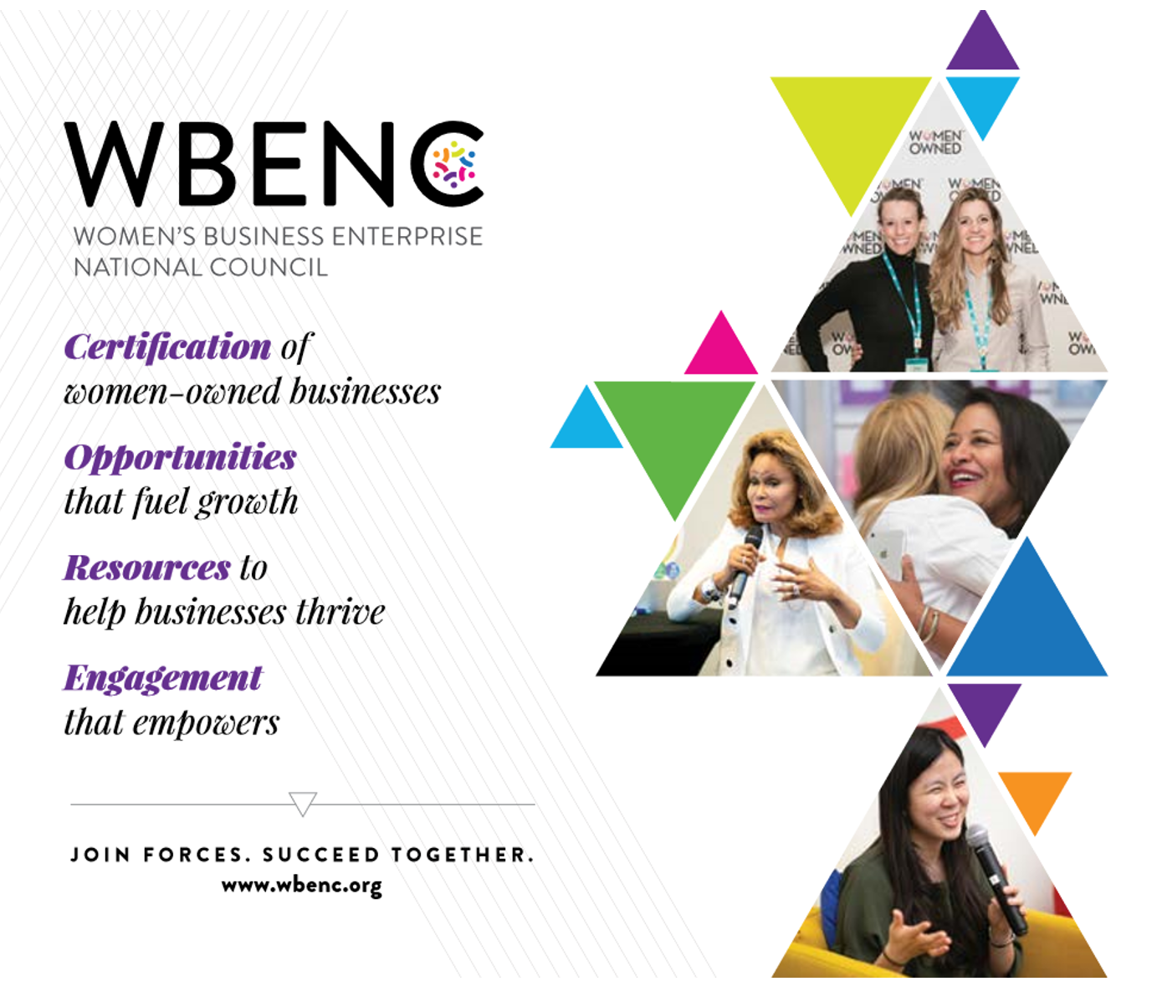




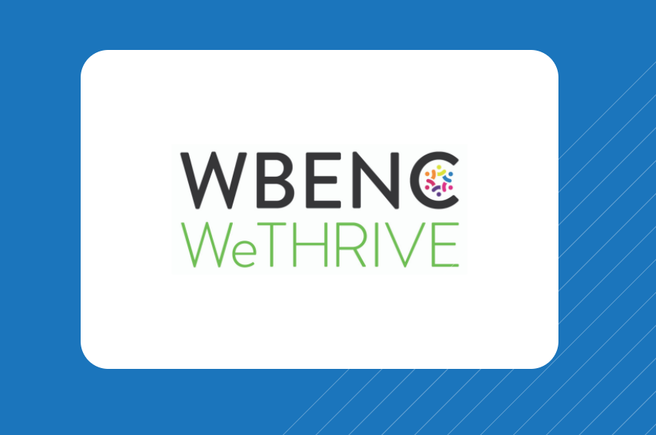
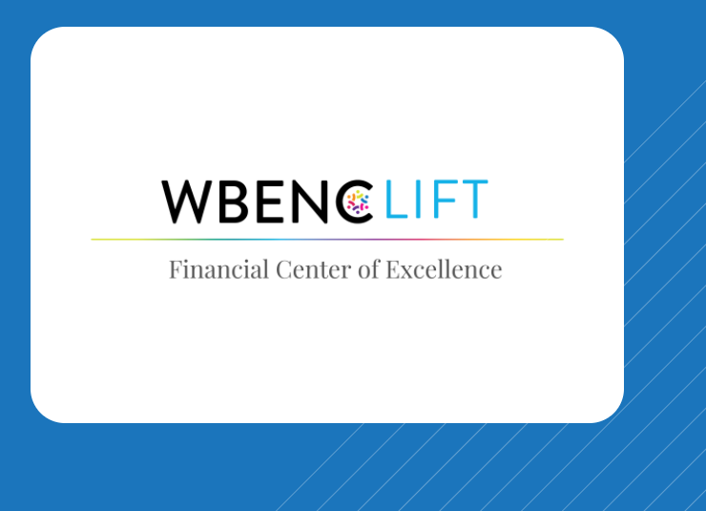
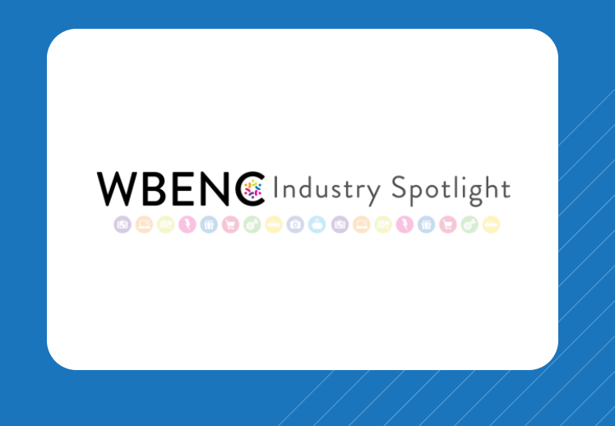

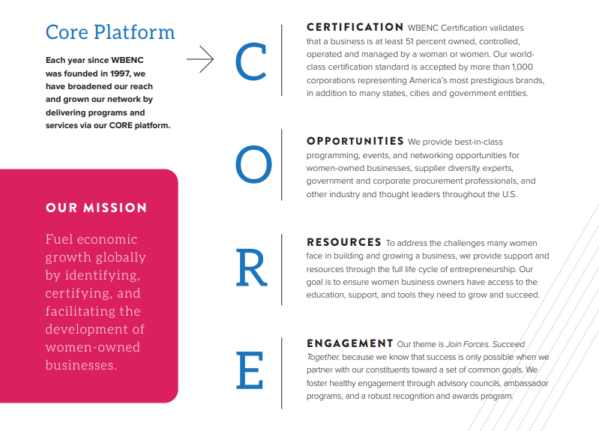





- 17,000+ WBEs
- 380 National Corporate & Government Members
- 14 Regional Partner Organizations
Executive Education
Network & Engagement​
Pitch Opportunities​​​​
Procurement Opportunities​​​​​​
1:1
MatchMakers
Industry
Match & Meet
Industry WBE Showcase
Scholarships & Grants​​​​
Dorothy B. Brothers Scholarship
& more programs.

Slide 10

NATIONAL VETERAN BUSINESS DEVELOPMENT COUNCIL
NATIONAL VETERAN BUSINESS DEVELOPMENT COUNCIL
Keith King –Founder & CEO
kking@nvbdc.org
501(C)(3) Non-Profit Organization

Slide 11
Diversify with Disability-Owned Business Enterprises (DOBEs ®)
Supplier Certification
Network Access
Peer Collaboration
Disability Inclusive Program Development
Contact: Philip@DisabilityIN.org

Slide 12




Who is NGLCC
The business voice of the LGBT community
  Direct link between LGBT business owners, corporations, and government
  Leading national policy advocates for LGBT economic inclusion
  Founder of the National Business Inclusion Consortium (NBIC) in 2011
  70 NGLCC affiliates in the U.S. and internationally
  Offices in Washington, DC and New York City
  Founded in 2002; NGLCC Global division established in 2014
Exclusive certifying body for LGBT Business Enterprises (LGBTBEs)
Hosts largest LGBT business event in the world, the NGLCC International Business & Leadership Conference
#LGBTBiz | @nglcc | nglcc.org

Slide 13
US Supplier Diversity Council Websites
National Minority Supplier Development Council (NMSDC): http://www.nmsdc.org
Women’s Business Enterprise National Council (WBENC): http://www.wbenc.org
National Gay & Lesbian Chamber of Commerce (NGLCC):
http://www.nglcc.org
National Veterans Business Development Council (NVBDC): https://nvbdc.org/
Disability:IN: https://disabilityin.org/what-we-do/supplier-diversity/

Slide 14
Q&A

Slide 15

Upcoming Supplier Citizenship Workshops
Registration open! (200 seats / session. P&G suppliers only)
Supplier Citizenship Workshops | Date
Meet the US Supplier Diversity Councils | May 4th
P&G Responsible sourcing program - Social Audits | May 11th
P&G's E&I employee pillar | May 18
P&G's Responsible Beauty | May 25th
P&G's 50L Home Project (Frantz Beznik) | June 8th
Self assessment tool for inclusive sourcing by Kearney | June 15th
P&G Responsible sourcing program - Human rights | June 22nd
P&G's Carbon neutral goal | June 29th
To register up to 3 workshops, go to IDloom link: https://proctergambleevents.events.idloom.com/p-and-g-workshops
email citizenship.im.1@pg.com with questions

Slide 16
Back Up Questions:
• How long has P&G been a member?
• What does it cost to become a member?
• How would I get involved in networking opportunities?
• What does it cost to certify and does that cost vary from one council to the next?

Slide 17
Thanks to everyone that participated today and huge thanks to all the diversity council leaders!

