Slide 1
P&G 2nd Tier Spending–
supplier.io
April 20, 2021

Slide 2
Welcome
P&G’s Supplier Diversity History
supplier.io overview
Tier 2 Diversity Spend Reporting Overview
Tier 2 Diversity Spend Reporting Process
Q&A
AGENDA
OVERVIEW

Slide 3
“We want to be a force for good and a
force for growth. We know that the more
we integrate and build Citizenship into how
we do business, the bigger the impact we
can have on the people we serve, the
communities we live in and the broader
world that surrounds us. In turn, that helps
us grow and build our business.”
DAVID S. TAYLOR,
Chairman of the Board,
President and Chief Executive Officer

Slide 4
P&G’s Supplier Diversity History
•P&G’s Supplier Diversity efforts began in 1976
•Began a formal 2ndTier program in 1996
•Inducted into the Billion Dollar Roundtable in 2005. This is the exclusive group of companies that invest a billion dollars a year or more with Diverse owned businesses.
•P&G has spent over $2 Billion with diverse suppliers since 2008
Notes:
Additional comment: We believe that 2nd Tier Spending is the most sustainable way to provide opportunities for minority owned companies which may not be able to supply P&G directly.
•Investing with diverse suppliers:
➢Strengthens our innovation and go-to-market capabilities.
➢Contributes to major employers of diverse groups
➢Touches and improves the lives of men and women who work in these companies and through them, their families and the communities in which they live and work.

Slide 5
supplier.io
Overview
supplier.io – Proprietary and Confidential

Slide 6
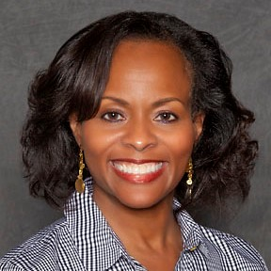
Presenter
Lois Eichacker VP, Customer Success
supplier.io
lois.eichacker@supplier.io
supplier.io – Proprietary and Confidential

Slide 7
Reporting Tier 2 Diversity Spend:
Contributing to the increased use of diverse vendors throughout the supply chain
supplier.io
supplier.io – Proprietary and Confidential

Slide 8
Agenda
Agenda
About supplier.io
Tier 2 Diversity Spend Reporting
What it is
Why it’s Important
Procter & Gamble’s Program
Tier 2 Spend Reporting Process
Are you ready?
What you’ll need
It’s easy!
Q&A
supplier.io – Proprietary and Confidential

Slide 9
ABOUT SUPPLIER.IO
supplier.io – Proprietary and Confidential

Slide 10
About supplier.io
1: About supplier.io
1,000,000+
Customer records updated every month
Leading provider of supplier diversity solutions
Experienced team - 18+ years Supplier Diversity
Used by over 350 companies
1 in 3 Fortune 100 companies use supplier.io
$38 billion+
Annual Tier 2 Spending Tracked
$42 billion+
Annual Diverse Tier 1 Spending supported
Mission:
Help supplier diversity programs increase spending with diverse suppliers through innovation and strategic processes.
200,000
Certifications updated every month
supplier.io – Proprietary and Confidential

Slide 11
Solutions for every stage of your program
1: About supplier.io
DISCOVER
Supplier Explorer
Supplier Registration
Supplier Prequalification
MANAGE
Data Enrichment
Unitier Tier 2 Reporting
Tier 2 Program Management
REPORT
Economic Impact Reports
Small Business Compliance and Reports
supplier.io – Proprietary and Confidential

Slide 12
TIER 2 DIVERSITY SPEND REPORTING
supplier.io – Proprietary and Confidential

Slide 13
What is Tier 2 Diverse Spend?
2: Tier 2 Diversity Spend Reporting
PROCTER & GAMBLE
What is it?
DIVERSE SUPPLIERS
TIER 1
(This is you)
NON-DIVERSE SUPPLIERS
DIVERSE SUPPLIERS
TIER 2
(These are your suppliers)
supplier.io – Proprietary and Confidential

Slide 14
The business case for Tier 2 Diverse Spend mirrors the business case for Tier 1 spend
2: Tier 2 Diversity Spend Reporting
Meet customer requirements
Win new business
Access to Innovation
Access to Talent
Brand and Reputation Management
Reducing costs
Why is it Important?
supplier.io – Proprietary and Confidential

Slide 15
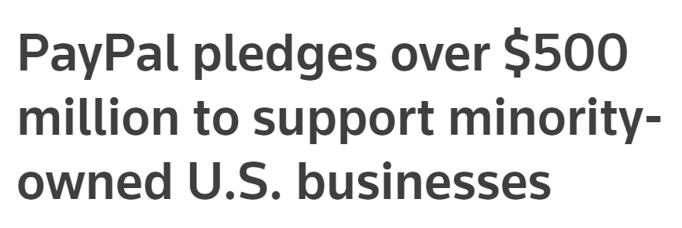
Your customers are increasing their focus on Supplier Diversity.
2: Tier 2 Diversity Spend Reporting
Why is it Important?
Target said it will spend more than $2 billion with Black-owned businesses by 2025 by adding new brands to its shelves, hiring Black-owned construction or advertising firms and launching a new program fort start-ups.
General Motors Vows to Send More Advertising Dollars to Black-Owned Media Companies
supplier.io – Proprietary and Confidential

Slide 16
Types of Tier 2 Diverse Spend
2: Tier 2 Diversity Spend Reporting
DIRECT versus INDIRECT
What is it?
REASON FOR YOUR DIVERSE SPENDING:
CUSTOMER
RELATED SUBCONTRACTS
OPERATIONAL ACTIVITIES
CATEGORY OF DIVERSE SPENDING:
DIRECT TIER 2 SPENDING
INDIRECT TIER 2 SPENDING
CERTIFIED versus SELF-CERTIFIED (Classified)
3RD PARTY CERTIFYING AGENCY
SUPPLIER-PROVIDED ATTESTATION / AFFIDAVIT
supplier.io – Proprietary and Confidential

Slide 17
2: Tier 2 Diversity Spend Reporting
Procter & Gamble Tier 2 Program
GLOBAL PROGRAM
U.S:
Suppliers from multiple diversity categories included
MBE, WBE, SDVET, VET, LGBT
Only spend with ‘Certified’ diverse suppliers counts
Countries outside of the U.S:
WBE suppliers only
Certified by WeConnect (agency) or supplier ‘Self-Certified’
supplier.io – Proprietary and Confidential

Slide 18
TIER 2 SPEND REPORTING PROCESS
supplier.io – Proprietary and Confidential

Slide 19
Tier 2 Diverse Spend Reporting Readiness Assessment
3: Tier 2 Spend Reporting Process
Do you know which of your suppliers are diverse (MBE, WBE, VBE, etc.)?
Does your Vendor Master allow you to record/update diversity indicators?
Can you generate “by-diversity category” spend reports on a quarterly basis?
Do you have access to a comprehensive database of diverse suppliers to search for new vendors?
Are you a member of WBENC, NMSDC or similar organizations that help to establish Programs and find qualified diverse suppliers?
Are you ready?
supplier.io – Proprietary and Confidential

Slide 20
Tier 2 Diverse Spend Reporting Required information
3: Tier 2 Spend Reporting Process
Spend by diversity category for your Indirect Tier 2 Spend
Diverse supplier company name and the spend amount for each supplier in the Direct Tier 2 Spend category
Your company’s sales for the Quarter
Your company’s sales to P&G for the Quarter
What do you need?
supplier.io – Proprietary and Confidential

Slide 21
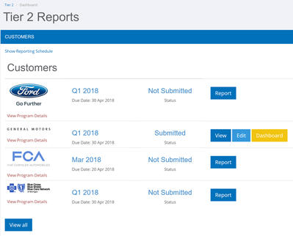
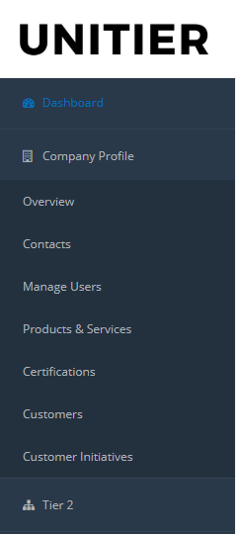
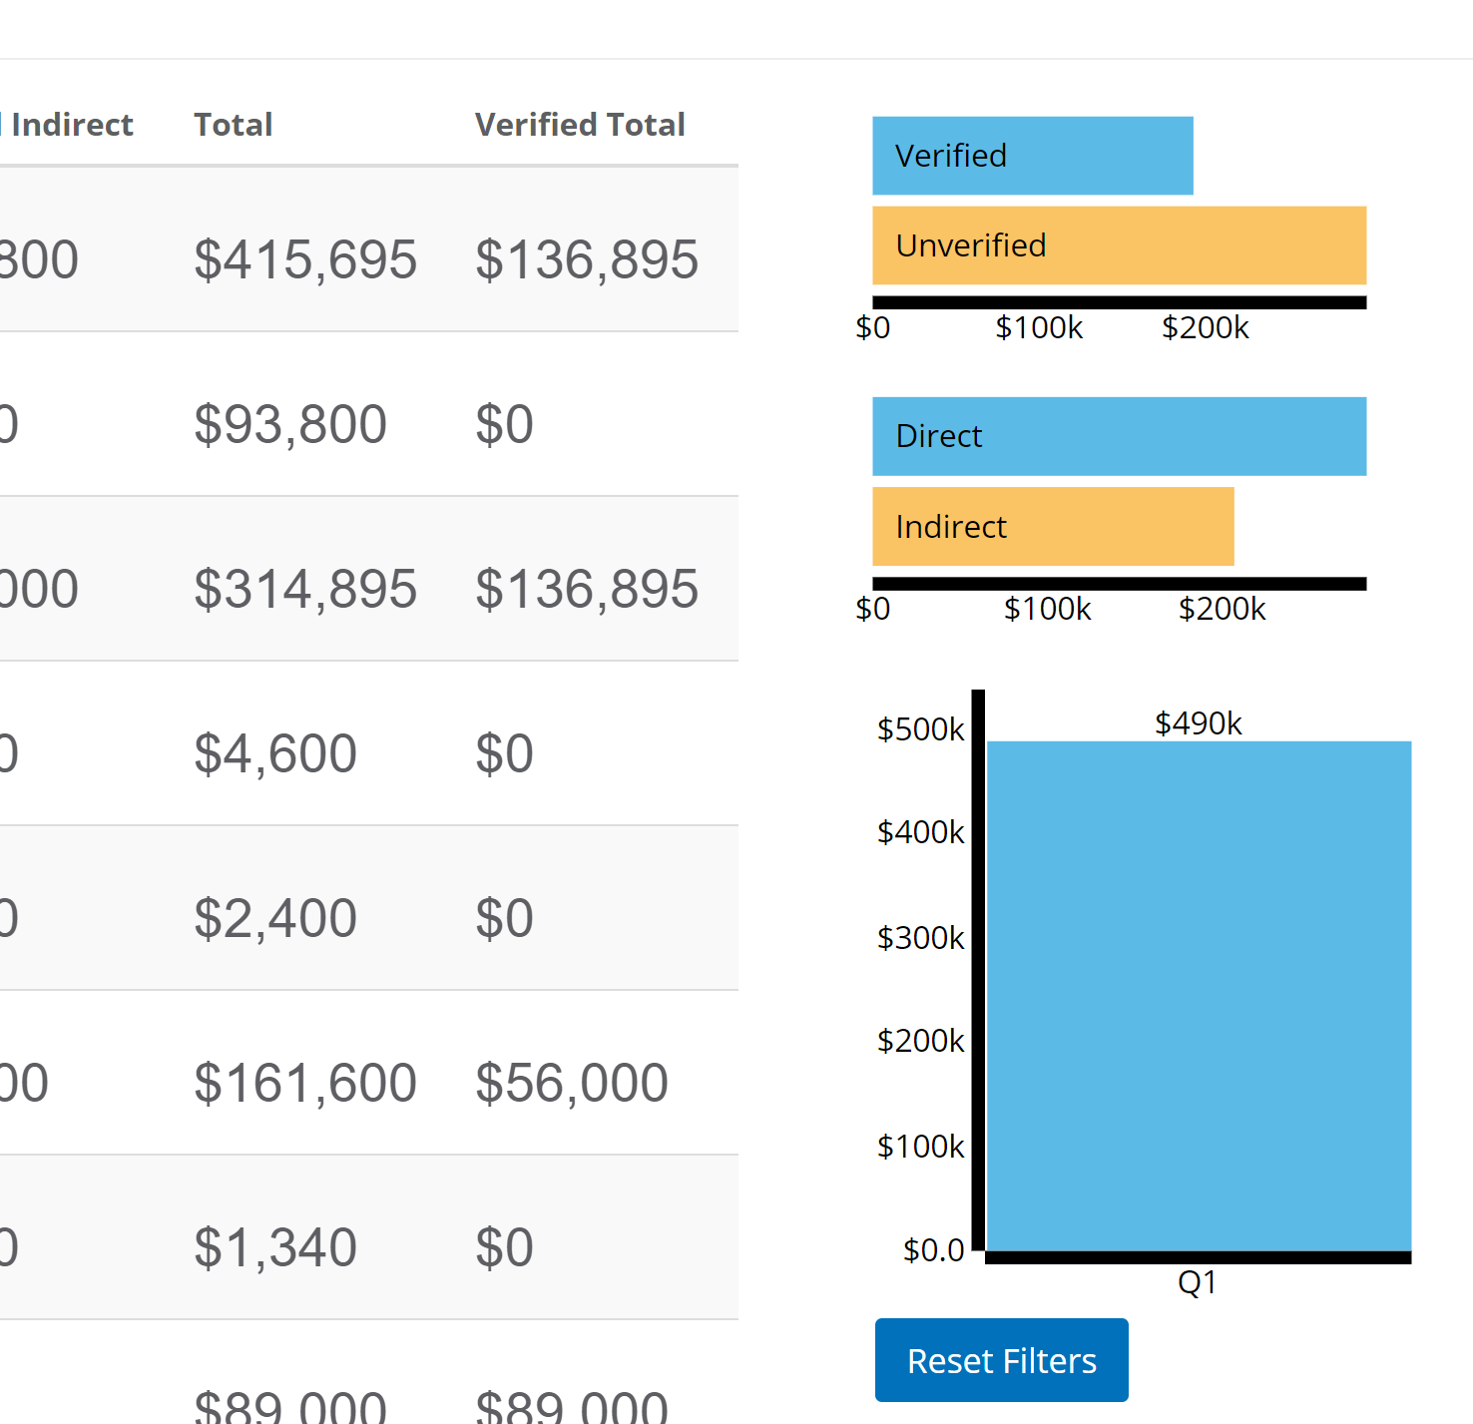
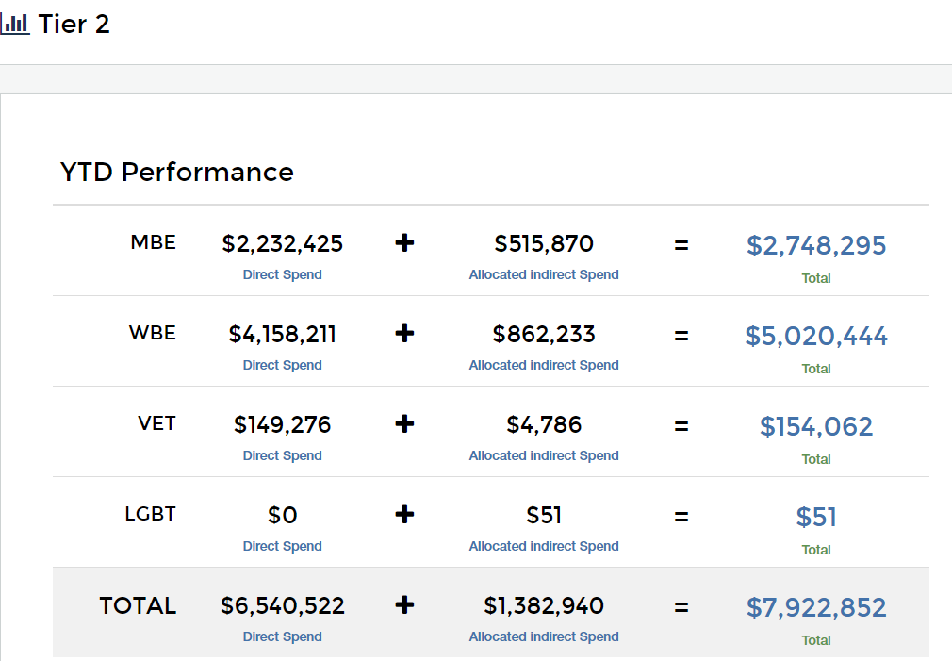
3: Tier 2 Spend Reporting Process
Reporting in UniTier - It’s easy!
Easy 3-step reporting process
Multi-Tenant Portal
Enter most data once - report to multiple customers
Quick file uploads
Pull supplier data directly from the supplier.io database
Dashboards to track reporting
Reporting refresher training available every quarter
In-app help
supplier.io – Proprietary and Confidential
supplier.io – Proprietary and Confidential

Slide 22
QUESTIONS & ANSWERS
supplier.io – Proprietary and Confidential

Slide 23
Tools & Resources
https://pgsupplier.com/supplier-diversity - this is where you’ll find more information about our supplier diversity efforts as well as out 2nd Tier Toolkit which highlights most of the information covered today.
To sign up in supplier.io and report your 2nd Tier spend, as well as for any related questions to our 2nd Tier efforts please contact me at alcalaspalazzi.ae@pg.com
For any supplier.io questions contact Lois Eichacker at lois.Eichacker@supplier.io

Slide 24
Thank You for Attending

